Slide 1

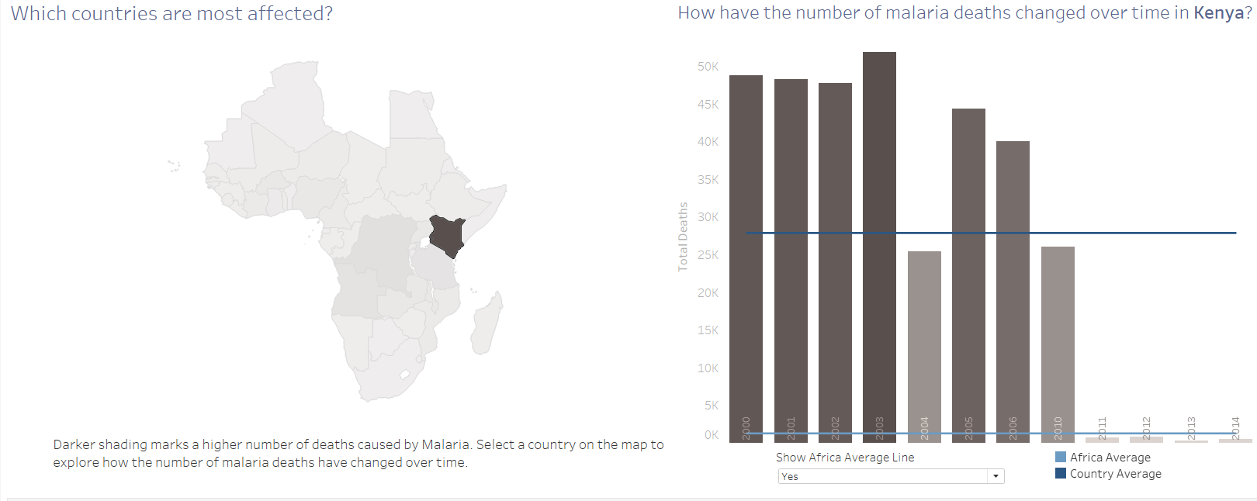
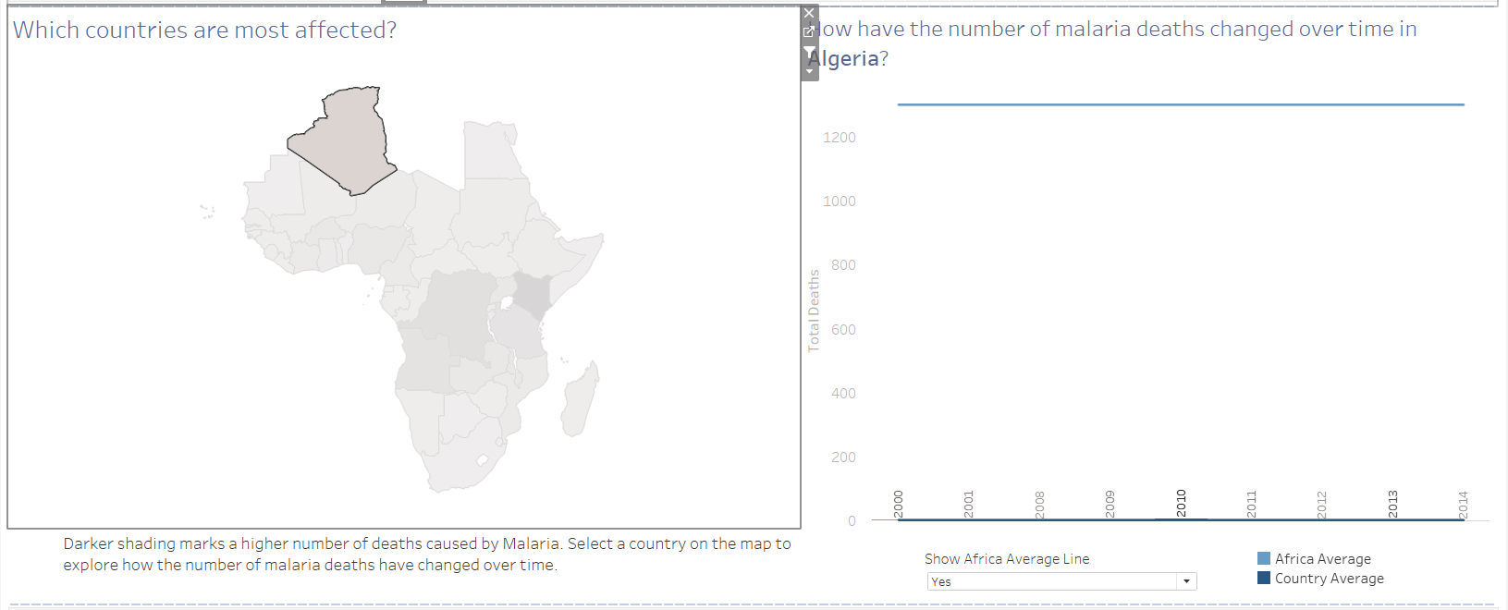
Kenya
Algeria
When I clicked on Kenya on the map it shows that, Kenya has an average of 27,896 deaths per year with an average of 76 deaths everyday. It is the country with most number of deaths with maximum number of deaths in 2003 and though the conditions improved going towards 2011with the least number of deaths in 2013
When I clicked on Algeria on the map it shows that, the biggest country of Africa, with the least number of deaths due to malaria Algeria has an average of 1 death due to malaria in Africa . It has been stagnant in the matter of deaths due to malaria throughout

Slide 2

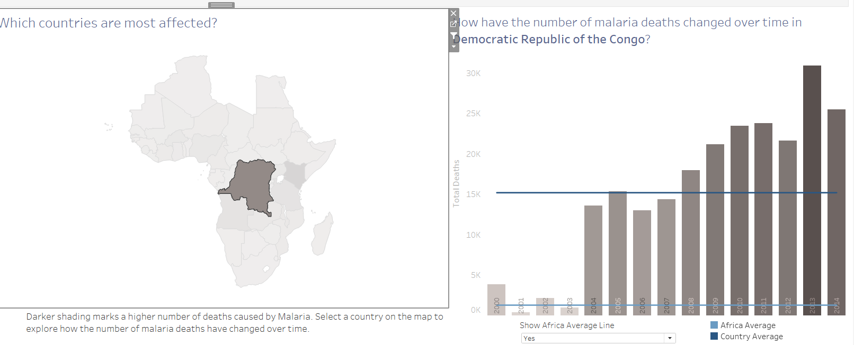
Democratic Republic of Congo
When I clicked on Congo on the map it shows that, With an average annual death rate of 15203 and per day death rate of 41-42 people Congo shows slightly different trends than other countries as they witnessed a decrease in death rate due to malaria Congo showed a significant rise over the years as the time passed with the maximum deaths in the year 2013

